Slide 1
Dr. S . Paulraj
M.Sc., M.Phil.,B.Ed.,Ph.D.
Professor of Mathematics
Anna University Chennai

Slide 2
Big M Method
It is a variation of the simplex method designed for solving Mixed constraints Linear Programming Problems.
The "Big M" refers to a large number associated with the artificial variables, represented by the letter M.

Slide 3
The following steps are involved in solving an LPP using the Big M method.
Step 1 : Express the problem in the standard form.
Step 2 : Add non-negative artificial variables to the left side of each of the equations corresponding to constraints of the type >, or = and =. However, addition of these artificial variable causes violation of the corresponding constraints. Therefore, we would like to get rid of these variables and would not allow them to appear in the final solution. This is achieved by assigning a very large penalty (-M for maximization and + M for minimization) in the objective function.

Slide 4
Step 3 : Rewrite the Objective function using the Artificial variables
added constraints
Step 4 : Solve the modified LPP by simplex method, until anyone of the three cases may arise.
If no artificial variable appears in the basis and the optimality conditions are satisfied, then the current solution is an optimal basic feasible solution.
If at least one artificial variable in the basis at zero level and the optimality condition is satisfied then the current solution is an optimal basic feasible solution (though degenerated solution).
If at least one artificial variable appears in the basis at positive level and the optimality condition is satisfied, then the original problem has no feasible solution. The solution satisfies the constraints but does not optimise the objective function, since it contains a very large penalty M and is called pseudo optimal solution.

Slide 5
Notes :
M, a very large number, is used to ensure that the values of artificial variables A₁ and A₂, …, and A_{n} will be zero in the final (optimal) tableau as follows:
1. If the objective function is Minimization, then A₁, A₂, …, and A_{n} must be added to the RHS of the objective function multiplied by a very large number (M).
Example: if the objective function is Min Z = X₁+2X₂, then the obj. function should be Min Z = X₁ + X₂+ MA₁ + MA₂+ …+ MA_{n}
OR
Z – X₁ - X₂- MA₁ - MA₂- …- MA_{n} = 0
2. If the objective function is Maximization, then A₁, A₂, …, and A_{n} must be subtracted from the RHS of the objective function multiplied by a very large number (M).
Example: if the objective function is Max Z = X₁+2X₂, then the obj. function should be Max Z = X₁ + X₂- MA₁ - MA₂- …- MA_{n}
OR
Z - X₁ - X₂+ MA₁ + MA₂+ …+ MA_{n} = 0
N.B.: When the Z is transformed to a zero equation, the signs are changed

Slide 6
Example 1:
Solve the following linear programming problem by using the Big M method
Min Z =2 X₁ + 3 X₂
S.t.
½ X₁ + ¼ X₂ ≤ 4
X₁ + 3X₂ ≥ 20
X₁ + X₂ = 10
X₁, X₂ ≥ 0

Slide 7
Step 1 &2 : Standard form
Min Z =2 X₁ + 3 X₂ + M A₁ +M A₂
s.t.
½ X₁ + ¼ X₂ + S₁ = 4
X₁ + 3X₂ - S₂ + A₁ = 20
X₁ + X₂ + A₂ = 10
X₁, X₂ ,S₁, S₂, A₁, A₂ ≥ 0
Where: M is a very large number

Slide 8
Initial tableau
Basic variables | X₁ ₂ | X₂ ₃ | S₁ ₀ | S₂ ₀ | A₁ _{M} | A₂ _{M} | RHS
S₁ | ½ | ¼ | 1 | 0 | 0 | 0 | 4
A₁ | 1 | 3 | 0 | -1 | 1 | 0 | 20
A₂ | 1 | 1 | 0 | 0 | 0 | 1 | 10
Z | -2 | -3 | 0 | 0 | -M | -M | 0
Note that one of the simplex rules is violated, which is the basic variables A₁, and A₂ have a non zero value in the z row; therefore, this violation must be corrected before proceeding in the simplex algorithm as follows.

Slide 9
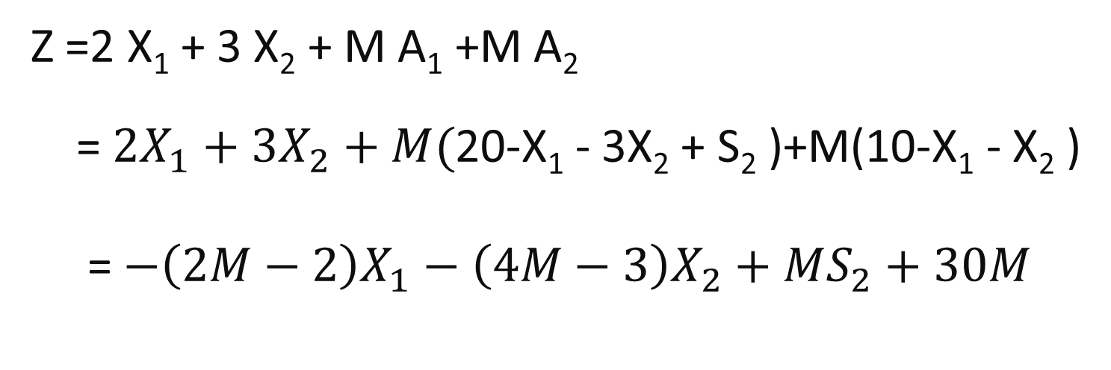
Step 3 : Rewrite the Objective function by using the second and third constraints, we have
Z =2 X₁ + 3 X₂ + M A₁ +M A₂
= $2X_{1}+3X_{2}+M($20-X₁ - 3X₂ + S₂ )+M(10-X₁ - X₂ )
= $−\left(2M−2\right)X_{1}−\left(4M−3\right)X_{2}+MS_{2}+30M$

Slide 10
The initial tableau of Modified LPP will be:
Basic variables | X₁ ₂ | X₂ ₃ | S₁ ₀ | S₂ ₀ | A₁ _{M} | A₂ _{M} | RHS
S₁ | 1/2 | 1/4 | 1 | 0 | 0 | 0 | 4
A₁ | 1 | 3 | 0 | -1 | 1 | 0 | 20
A₂ | 1 | 1 | 0 | 0 | 0 | 1 | 10
Z | 2M-2 | 4M-3 | 0 | -M | 0 | 0 | 30M
Since there is a positive value in the last row, this solution is not optimal
The entering variable is X₂ (it has the most positive value in the last row)
The leaving variable is A₁ (it has the smallest ratio)

Slide 11
First iteration
Basic variables | X₁ ₂ | X₂ ₃ | S₁ ₀ | S₂ ₀ | A₁ _{M} | A₂ _{M} | RHS
S₁ | 5/12 | 0 | 1 | 1/12 | -1/12 | 0 | 7/3
X₂ | 1/3 | 1 | 0 | -1/3 | 1/3 | 0 | 20/3
A₂ | 2/3 | 0 | 0 | 1/3 | -1/3 | 1 | 10/3
Z | 2/3M-1 | 0 | 0 | 1/3M-1 | 1-4/3M | 0 | 20+10/3M
Since there is a positive value in the last row, this solution is not optimal
The entering variable is X₁ (it has the most positive value in the last row)
The leaving variable is A₂ (it has the smallest ratio)

Slide 12
Second iteration
Basic variables | X₁ | X₂ | S₁ | S₂ | A₁ | A₂ | RHS
S₁ | 0 | 0 | 1 | -1/8 | 1/8 | -5/8 | 1/4
X₂ | 0 | 1 | 0 | -1/2 | 1/2 | -1/2 | 5
X₁ | 1 | 0 | 0 | 1/2 | -1/2 | 3/2 | 5
Z | 0 | 0 | 0 | -1/2 | ½-M | 3/2-M | 25
This solution is optimal, since there is no positive value in the last row. The optimal solution is:
X₁ = 5, X₂ = 5, S₁ = ¼
A₁ = A₂ = 0 and Z = 25

Slide 13
Note for the Big M method
In the final tableau, if one or more artificial variables (A₁, A₂, …) still basic and has a nonzero value, then the problem has an infeasible solution.
All other notes are still valid in the Big M method.

Slide 14
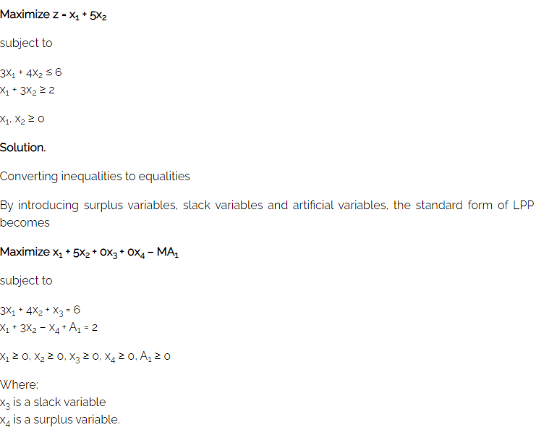
Example 2 :

Slide 15
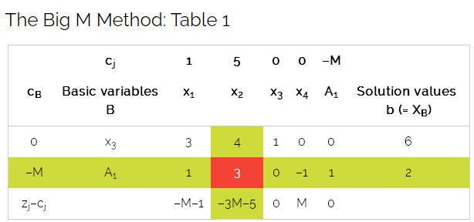

Slide 16
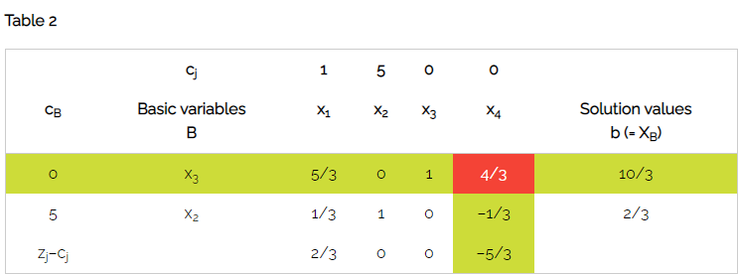

Slide 17
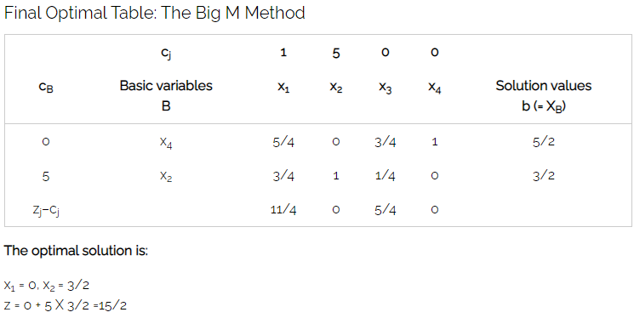

Slide 18
Artificial Starting Solution :
Two-phase method
When a basic feasible solution is not readily available, the two-phase simplex method may be used as an alternative to the big M method.
In the two-phase simplex method, we add artificial variables to the same constraints as we did in big M method. Then we find a basic feasible solution to the original LP by solving the Phase I LP.
In the Phase I LP, the objective function is to minimize the sum of all artificial variables.
At the completion of Phase I, we use Phase II and reintroduce the original LP’s objective function and determine the optimal solution to the original LP.

Slide 19
Artificial Starting Solution:
Note:
In Phase I, If the optimal value of sum of the artificial variables are greater than zero, the original LP has no feasible solution which ends the solution process. Other wise, We move to Phase II
Example
Minimize
Subject to:

Slide 20

Artificial Starting Solution:
Solution:
Phase I:
Minimize:
Subject to:
Where $R_{1}, R_{2}$ are the Artificial variables

Slide 21
Artificial Starting Solution :
Solution | x₄ | R₂ | R₁ | x₃ | x₂ | x₁ | Basic
0 | 0 | -1 | -1 | 0 | 0 | 0 | r
3 | 0 | 0 | 1 | 0 | 1 | 3 | R₁
6 | 0 | 1 | 0 | -1 | 3 | 4 | R₂
4 | 1 | 0 | 0 | 0 | 2 | 1 | x4
New r-row = Old r-row + 1* R₁-row + R₂ -row
Solution | x₄ | R₂ | R₁ | x₃ | x₂ | x₁ | Basic
9 | 0 | 0 | 0 | -1 | 4 | 7 | r
3 | 0 | 0 | 1 | 0 | 1 | 3 | R₁
6 | 0 | 1 | 0 | -1 | 3 | 4 | R₂
4 | 1 | 0 | 0 | 0 | 2 | 1 | x4

Slide 22
Artificial Starting Solution :
By using new r-row, we solve Phase I of the problem which yields the following optimum tableau
Solution | x₄ | R₂ | R₁ | x₃ | x₂ | x₁ | Basic
0 | 0 | -1 | -1 | 0 | 0 | 0 | r
3/5 | 0 | -1/5 | 3/5 | 1/5 | 0 | 1 | x₁
6/5 | 0 | 3/5 | -4/5 | -3/5 | 1 | 0 | x₂
1 | 1 | -1 | 1 | 1 | 0 | 0 | x4
Because minimum r=0, Phase I produces the basic feasible solution:

Slide 23
Artificial Starting Solution :
Phase II
After eliminating artificial variables column, the original problem can be written as:
Minimize:
Subject to:

Slide 24
Artificial Starting Solution :
Solution | x₄ | x₃ | x₂ | x₁ | Basic
0 | 0 | 0 | -1 | -4 | z
3/5 | 0 | 1/5 | 0 | 1 | x₁
6/5 | 0 | -3/5 | 1 | 0 | x₂
1 | 1 | 1 | 0 | 0 | x4
Again, because basic variables x₁ and x₂ have nonzero coefficient in the z row, they must be substituted out, using the following computation:
New z-row = Old z-row + 4* x₁-row + 1*x₂ -row

Slide 25
Artificial Starting Solution :
The initial tableau of Phase II is as the following:
Solution | x₄ | x₃ | x₂ | x₁ | Basic
18/5 | 0 | 1/5 | 0 | 0 | z
3/5 | 0 | 1/5 | 0 | 1 | x₁
6/5 | 0 | -3/5 | 1 | 0 | x₂
1 | 1 | 1 | 0 | 0 | x4

Slide 26
Artificial Starting Solution :
Remarks:
The removal of artificial variables and their column at the end of Phase I can take place only when they are all nonbasic. If one or more artificial variables are basic ( at zero level) at the end of Phase I, then the following additional steps must be under taken to remove them prior to start Phase II
Step 1. Select a zero artificial variable to leave the basic solution and designate its row as pivot row. The entering variable can be any nonbasic (nonartificial) variable with nonzero (positive or negative) coefficient in the pivot row. Perform the associated simplex iteration.
Step 2. Remove the column of the (Just-leaving) artificial from the tableau. If all the zero artificial variables have been removed , go to Phase II. Otherwise, go back to Step I.

Slide 27
THANK YOU

